Slide 1

Ad-Tech Platform for
Media Discovery and Planning

Slide 2
Campaign Name
www.excellentpublicity.com

Slide 3
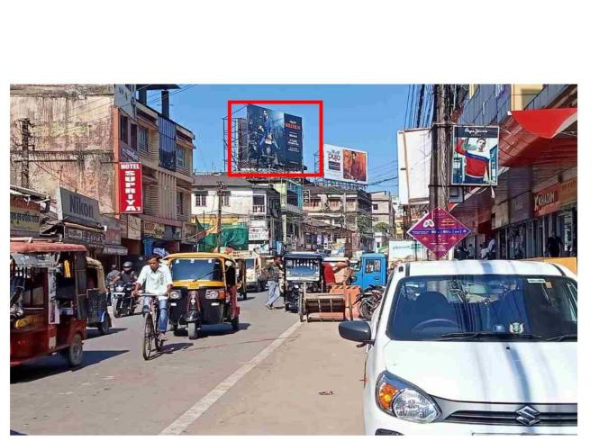
Bhuj, Airport Road Opp Prince Residency - LHS - 20x10 - NL
Media Type : Hoarding | Type : NL
Start Date : 13Jun26 | Photo Type : Newspaper/ Long Shot / Close Short / GPS
www.excellentpublicity.com

Slide 4
THANK YOU
Let’s Build Success Together!
www.excellentpublicity.com

